Slide 1
Michigan County Opioid Settlement Funds PowerPoint Template

Slide 2
Scope of Substance Use

Slide 3
County-Specific Data
Provide county-specific data around
Number of overdose fatalities
Number of non-fatal overdoses
Number of EMS responses to possible overdoses
Number of ED visits for overdose
Number of hospital admissions for overdose
Number of prescriptions
Number of people presenting in the jail with a need for SUD treatment
Number of people treated for SUD within the jail
Number of people accessing local SSP(s)
Other relevant data

Slide 4
Opioid Settlements

Slide 5
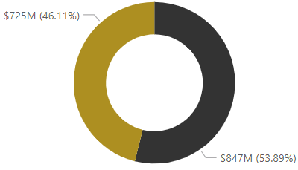
Opioid Settlements Overview
Total estimated funds coming to Michigan - $1,572,482,366
Total estimated state share - $847,440,366
Total estimated subdivision share - $725,042,000
Estimated totals from settlements with:
Distributors (McKesson, Cardinal Health, and AmerisourceBergen)
J&J
Walgreens
CVS
Teva
Allergan
McKinsey & Co.
Mallinckrodt
Meijer

Slide 6
J&J and Distributors Settlements
The state of Michigan is slated to receive nearly $776 million over 18 years from two settlements, Distributors (McKesson, Cardinal Health and AmerisourceBergen) and J&J
50% of the settlement amount will be sent directly to county and local governments
Allocation percentages can be found in Exhibit A of the Michigan State-Subdivision Agreement for Allocation of Distributor Settlement Agreement and Janssen Settlement Agreement
Distribution to subdivisions began on January 31, 2023
Bi-annual reporting on non-opioid remediation activities
Tribal settlements are separate
Opioid Settlement Resource Center - The Michigan Association of Counties (micounties.org)

Slide 7
Pharmacy and Manufacturer Settlements
Expected to bring in around $735 million to Michigan
Sign-on for settlements with CVS, Walmart, Allergan and Teva are complete
Local subdivision sign-on for Walgreens settlement has not started
50% of the settlement amount will be sent directly to county and local governments
Distribution has not started
Bi-annual reporting on non-opioid remediation activities
Tribal settlements are separate
Meijer is a separate, non-national, settlement for which 4 counties, 3 cities, and 6 townships received funds during the summer of 2023
No reporting requirements or specified allowable uses
Opioid Settlement Resource Center - The Michigan Association of Counties (micounties.org)

Slide 8
Additional Settlements
Settlements pursuing bankruptcy plans
Mallinckrodt is expected to bring in $37 million to Michigan
First payments made in May 2023
Potential to not receive all funds
30% to state/non-regional use
70% to regional use
5 counties with direct distribution of funds
Remaining funds allocated based on recommendations from Michigan Opioids Task Force
Annual activity and financial reporting required
Schedule A outlines allowable uses of funds
Expected to take place in the future
Purdue Pharma
Endo
Distribution process, requirements on spending and reporting are will differ from other settlements

Slide 9
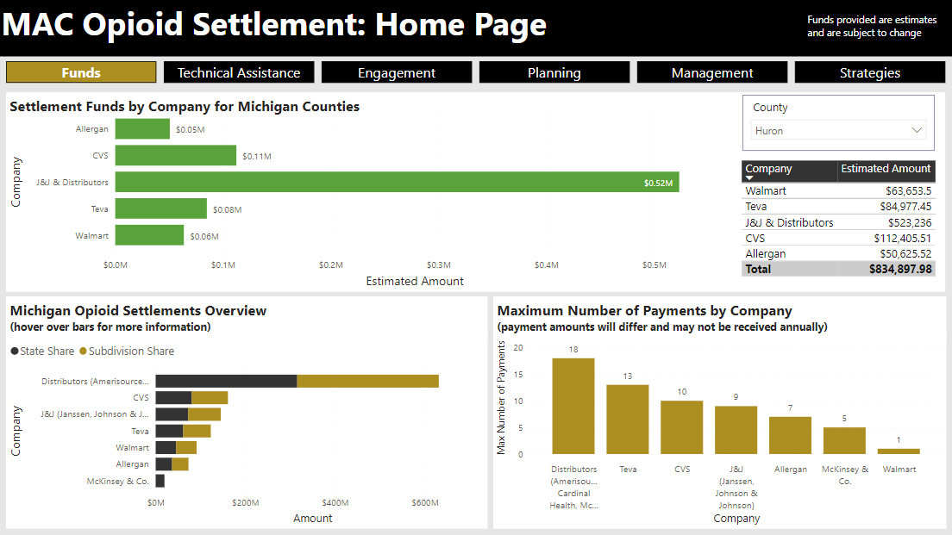
MAC Settlement Dashboard
Use MAC Dashboard to pull expected county funds
https://micounties.org/opioid-settlement-resource-center/

Slide 10
County Settlement Background
Outline details specific to county sign-on, litigation, etc.

Slide 11
Strategies for Spending

Slide 12
Exhibit E Overview – Core Strategies
Settlements outline specific strategies for utilization of funds, including:
Core Strategies:
Naloxone or other FDA-approved drug to reverse opioid overdoses
Medication-assisted Treatment (MAT) distribution and other opioid-related treatment
Address needs of pregnant and postpartum women
Expanding treatment for Neonatal Abstinence Syndrome (NAS)
Expansion of warm hand-off programs and recovery services
Treatment for incarcerated population
Prevention programs
Expanding syringe service programs
Evidence-based data collection and research analyzing the effectiveness of the abatement strategies within the state
Exhibit E (Attorney General)

Slide 13
Exhibit E Overview – Approved Uses
Approved Uses – Treatment:
Treat Opioid Use Disorder (OUD)
Support people in treatment and recovery
Connect people who need help to the help they need (connections to care)
Address the needs of criminal justice-involved persons
Address the needs of pregnant or parenting women and their families, including babies with NAS
Exhibit E (Attorney General)

Slide 14
Exhibit E Overview – Approved Uses
Approved Uses – Prevention:
Prevent over-prescribing and ensure appropriate prescribing and dispensing of opioids
Prevent misuse of opioids
Prevent overdose deaths and other harms (harm reduction)
Exhibit E (Attorney General)

Slide 15
Exhibit E Overview – Approved Uses
Approved Uses – Other Strategies:
Support first responders
Leadership, planning and coordination
Training
Research
Exhibit E (Attorney General)

Slide 16
Steps for Spending

Slide 17
Stakeholder Engagement
Explain stakeholder engagement process or planning process
Outline equity considerations
Outline inclusion of those with lived experience with substance use disorder or people who use drugs

Slide 18
Local Data & Information
Outline the information gathered to aid in decision-making
Strategic plans
Landscape analyses
Action plans
Etc.
Explain data utilized to aid in decision-making
Outline any equity considerations in data

Slide 19
Process
Explain process for choosing where to start
Explain process for decision-making

Slide 20
Monitoring & Accountability
Explain process for transparency and accountability
Explain what types of annual reporting or publicly-available data/dashboards/reports/briefs that will be completed and made available Explain how effectiveness of funding will be captured

Slide 21
County Spending
Add in overview of spending plan

Slide 22
Strategy 1
State activity/strategy being funded
Outline the proposed impact or goal of the funding
Outline the target audience of the activity/strategy
Note amount of funds allocated
Note if funds are recurring or one-time
(In future years, outline the impact of the work/what has changed as a result of the efforts)

Slide 23
Strategy 2
State activity/strategy being funded
Outline the proposed impact or goal of the funding
Outline the target audience of the activity/strategy
Note amount of funds allocated
Note if funds are recurring or one-time
(In future years, outline the impact of the work/what has changed as a result of the efforts)

Slide 24
Strategy 3
State activity/strategy being funded
Outline the proposed impact or goal of the funding
Outline the target audience of the activity/strategy
Note amount of funds allocated
Note if funds are recurring or one-time
(In future years, outline the impact of the work/what has changed as a result of the efforts)

Slide 25
Strategy 4
State activity/strategy being funded
Outline the proposed impact or goal of the funding
Outline the target audience of the activity/strategy
Note amount of funds allocated
Note if funds are recurring or one-time
(In future years, outline the impact of the work/what has changed as a result of the efforts)

Slide 26
Strategy 5
State activity/strategy being funded
Outline the proposed impact or goal of the funding
Outline the target audience of the activity/strategy
Note amount of funds allocated
Note if funds are recurring or one-time
(In future years, outline the impact of the work/what has changed as a result of the efforts)

Slide 27
Next Steps
Outline next steps associated with planning for, or utilization of, opioid settlement funds

Slide 28
Questions

Slide 29
Contact

